Slide 1
Welcome to cs50 Section!
Please form groups of 3 and start the activity!

Slide 2
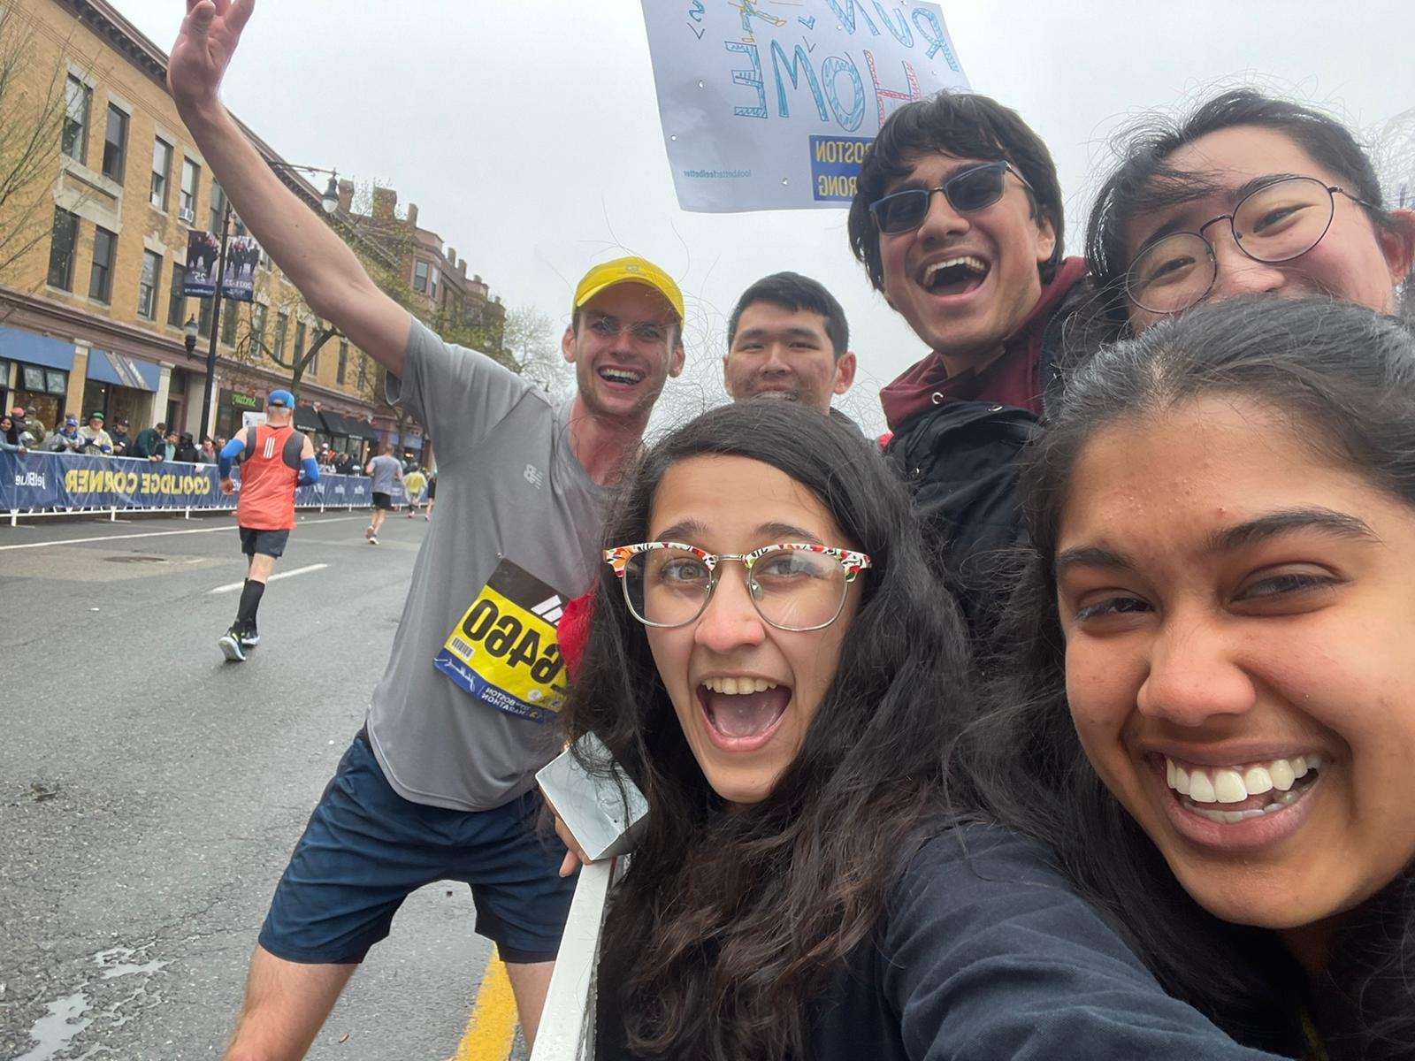
Andrew Holmes Cabot House, Senior
B.A. in Computer Science
Some of my passions:
Running
Soccer
Dog walking & hiking
Card & board games
Video games
Teaching!
aholmes@college.harvard.edu

Slide 3
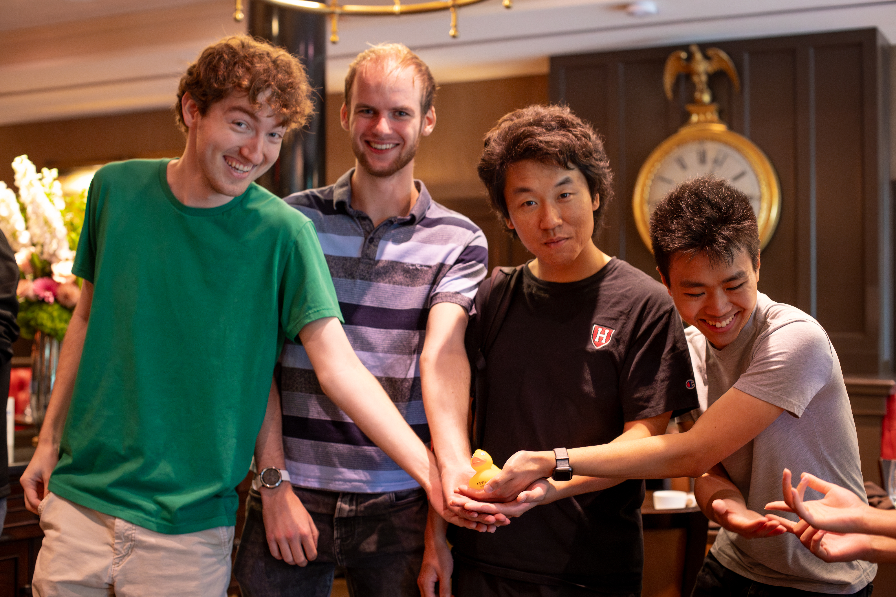
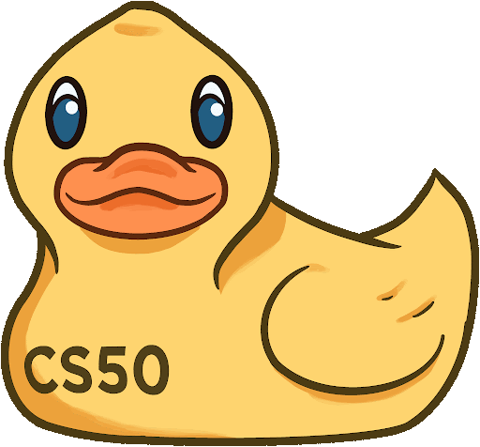
My Teaching
Fall 2021: CS50 CA
Spring 2022: CS51 CA
Fall 2022: CS50 TF
Spring 2022: CS124 TF
Fall 2023: CS50 Head TF

Slide 4
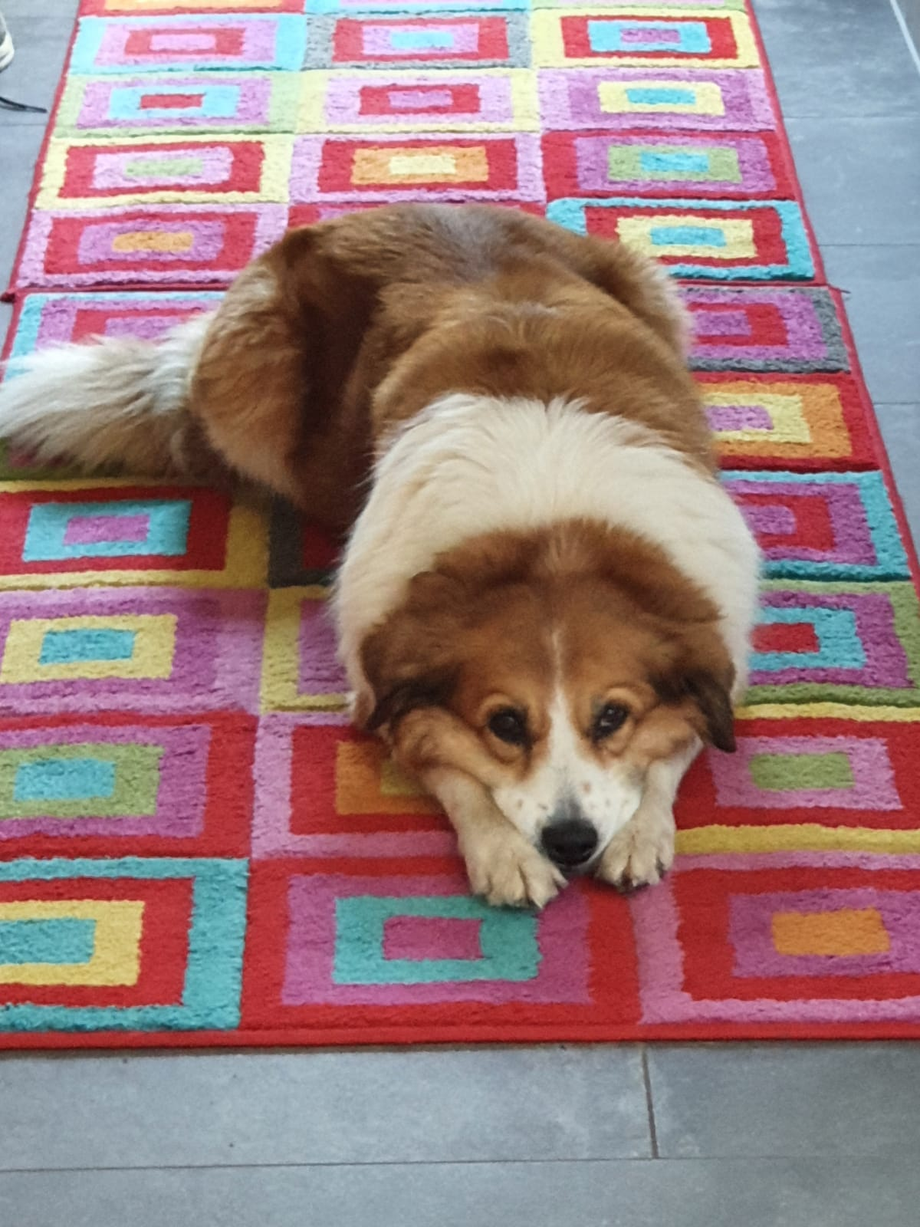
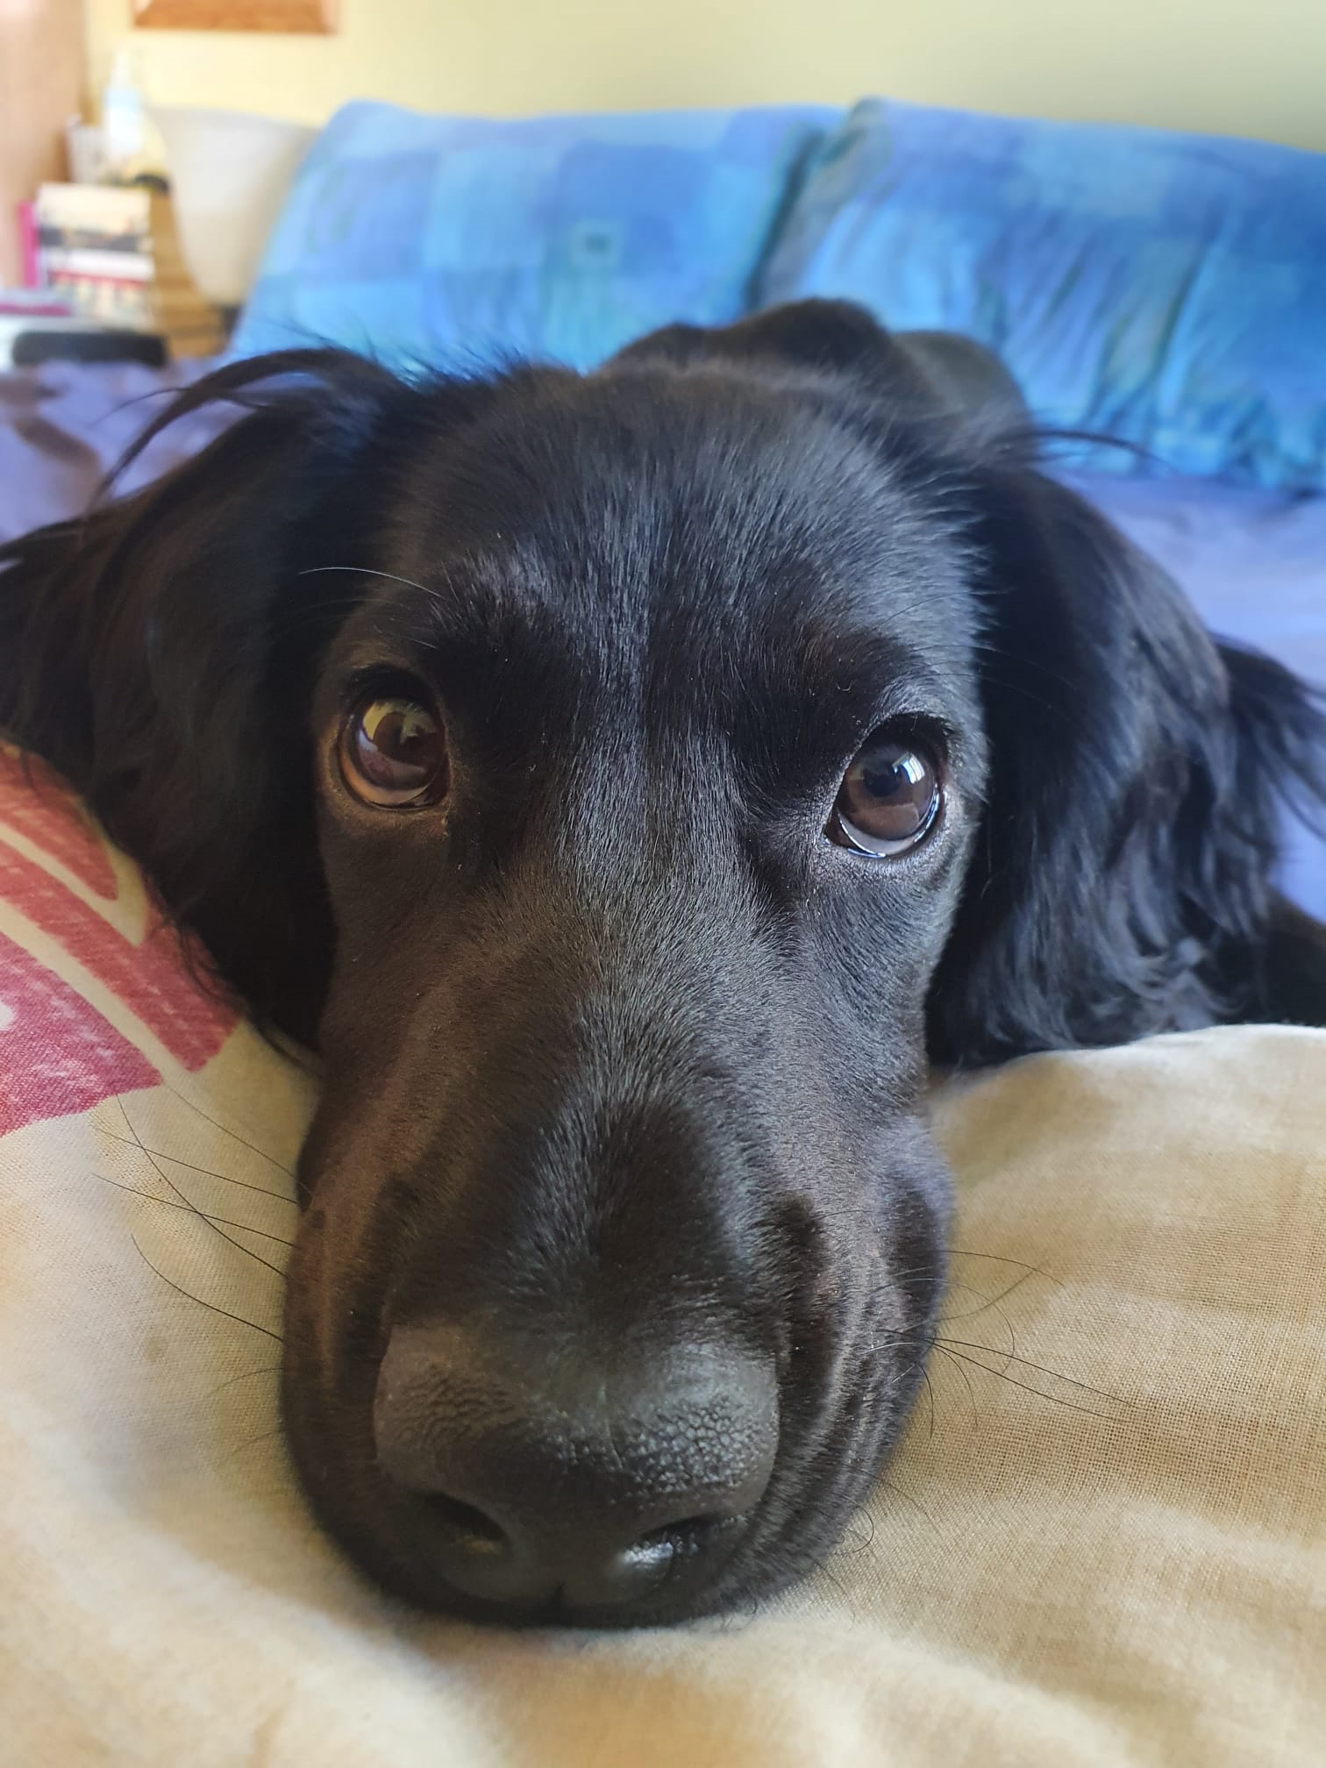
My Classes
Current
CS165: Data Systems
CS153: Compilers
EXPOS 40: Public Speaking
?
Past (CS-related)
CS124, CS181, CS182, CS262, CS238, CS91, CS121, CS61, CS51, CS50, STAT110, Math22a, Math22b

Slide 5
Weekly Course Schedule
Logistics
 |  | Mon | Tue | Wed | Thu | Fri | Sat | Sun
Lecture
Section
Office Hours
Sunday OHs

Slide 6
Section
Logistics
Section is…
Section is not…
A review session to consolidate lecture understanding.
A place to meet friends in the class!
A place to practice what you’ve learned…
and to ask questions about things you still find confusing!
A small, supportive group effort.
We’re here to have fun while learning!
The place for fixing your PSET code (that’s office hours!)
The place for being on your phone.
A place to be rude, unsupportive or in any way not cool to others – I will not tolerate it.
Optional… it’s required for attendance points for you grade :P
If you can’t make it one week, please contact me so I can help!

Slide 7
cs50 section 1
Intro to C
Andrew Holmes, Fall 2023

Slide 8
Today’s Plan
Scratch → C
C Syntax dive
01
03
Writing your code
PSET thoughts
02
04
From blocks to your first lines of code :)
Delving deeper into C’s syntax!
Getting setup with cs50.dev and writing some code!
Taking a look at PSET 1!

Slide 9
01
Scratch → C
Converting our Scratch understanding to our first programming language!

Slide 10
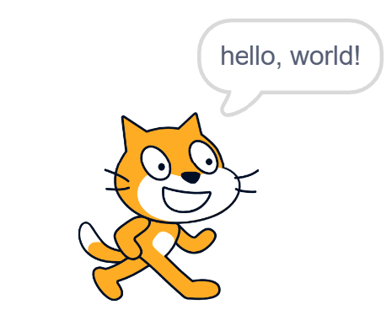
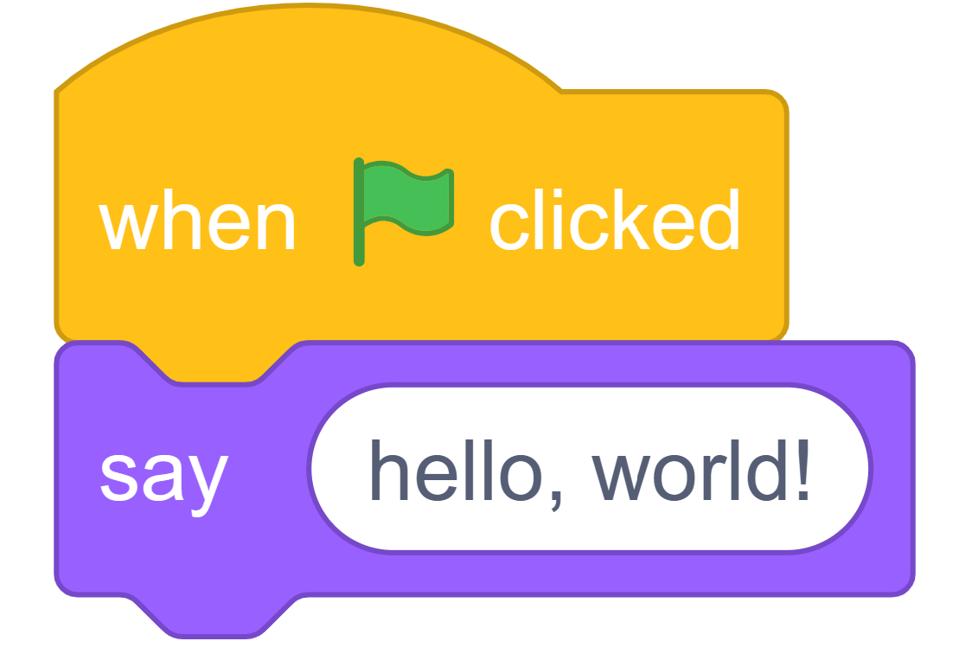
Basic Scratch program
Scratch → C

Slide 11
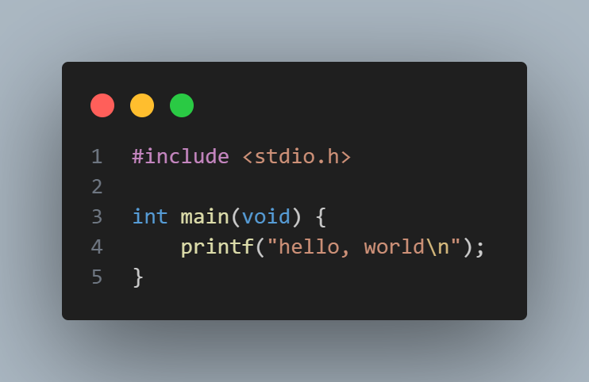
C Equivalent for hello world
Scratch → C

Slide 12
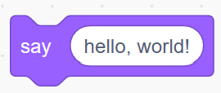
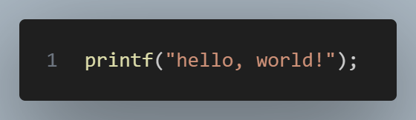
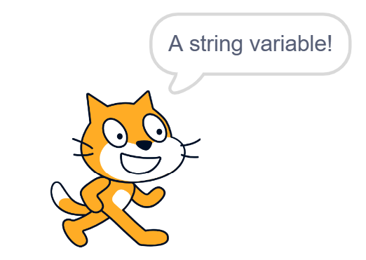
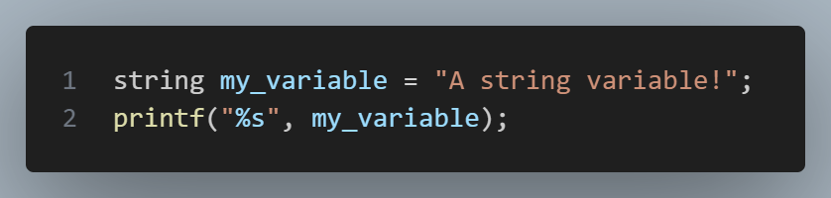
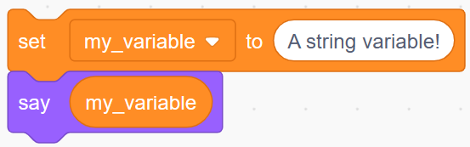
Scratch ‘say’, C printf
Scratch → C
printf → print formatted string

Slide 13
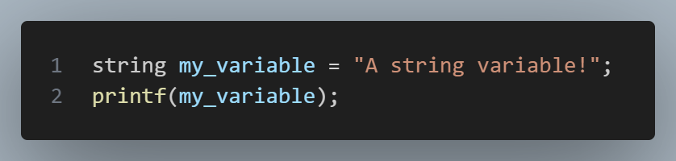
But Andrew… Y
Scratch → C

Slide 14
Scratch → C
VS
DON’T DO THIS ONE. IT CAN BE USED BY HACKERS TO EDIT YOUR MEMORY.

Slide 15
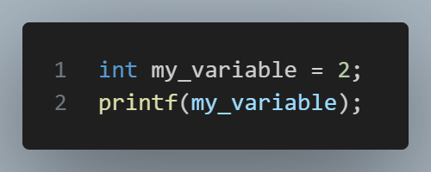
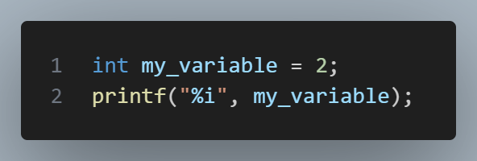
It also prevents…
Scratch → C
INVALID C syntax. printf REQUIRES a string as input.
VALID C. my_variable is an int, but is formatted as a string.

Slide 16
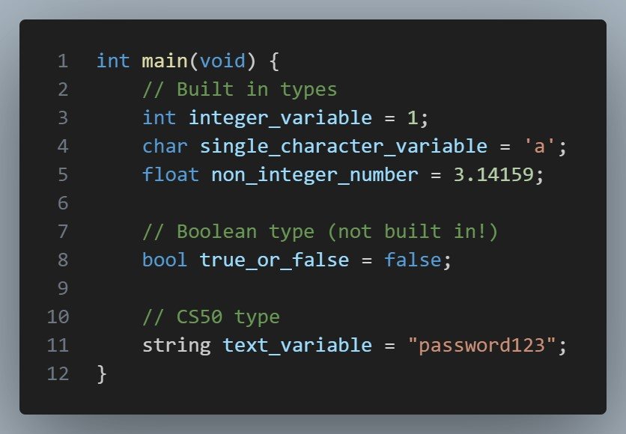
Types in C
Scratch → C

Slide 17
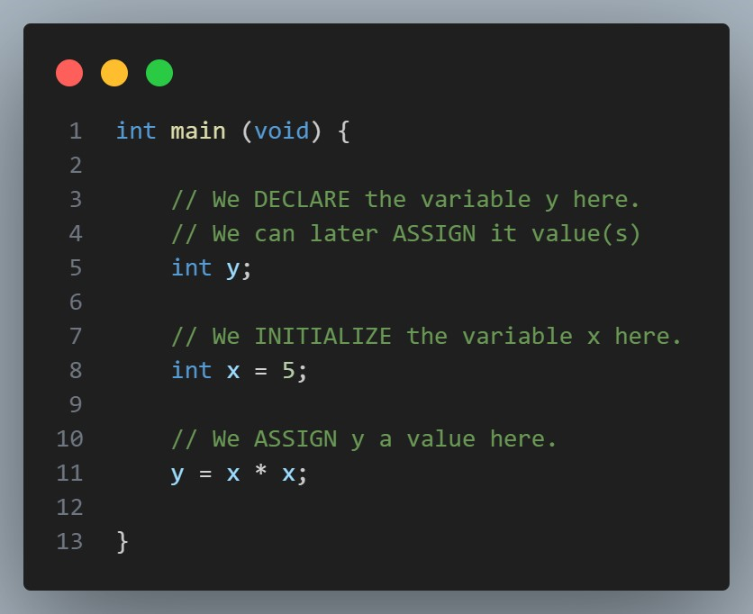
Types in C
Scratch → C

Slide 18
02
Writing code
Getting used to cs50’s tools, mainly cs50.dev.

Slide 19
cs50.dev
cs50.harvard.edu
Gradescope
Ed
Office Hours booking
cs50.ai

Slide 20
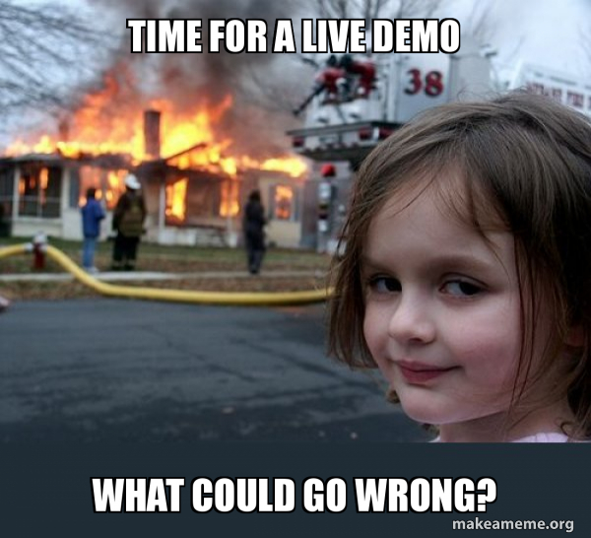

Slide 21
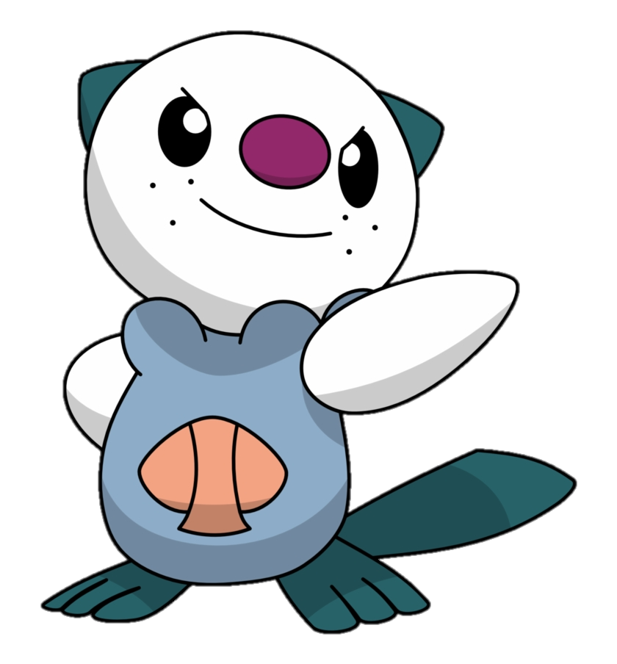
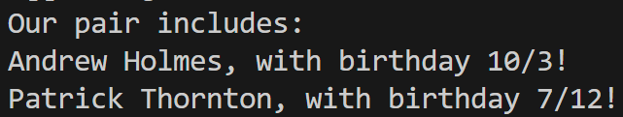
Prac
In pairs, write info.c, which should:
Initialize two string variables, with your names.
Initialize four int variables, with your respective birth day and month.
Print to the terminal like so:
Practice!

Slide 22
03
C deep dive
Understanding C syntax better!

Slide 23
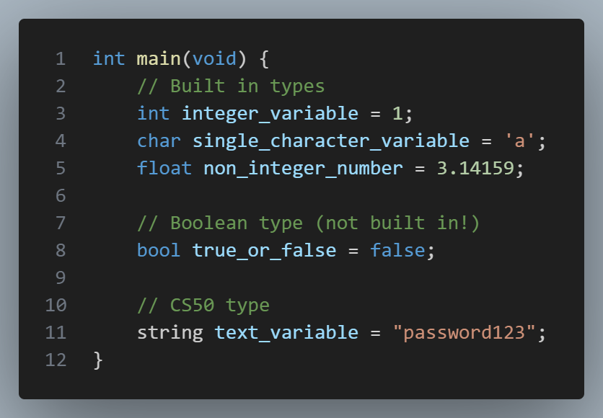
Declaring & Initializing a variable
C syntax

Slide 24
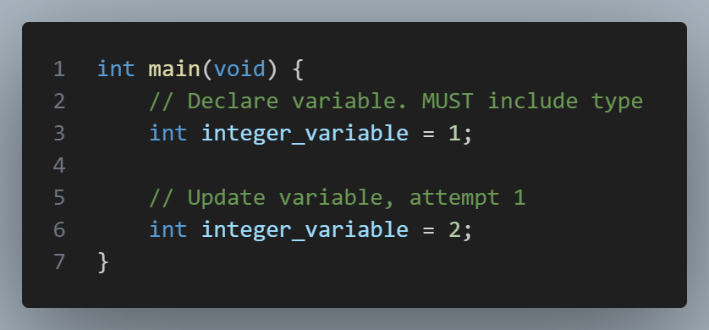
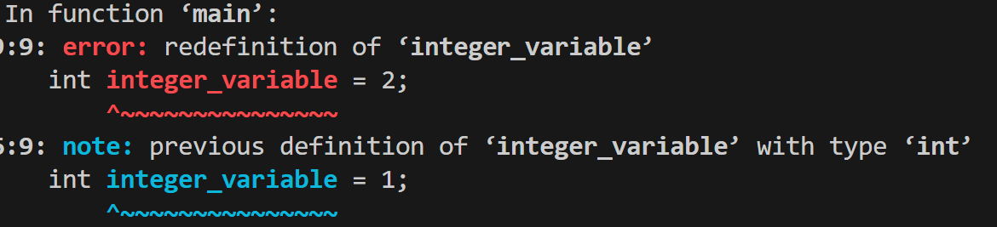
Updating a variable
C syntax

Slide 25
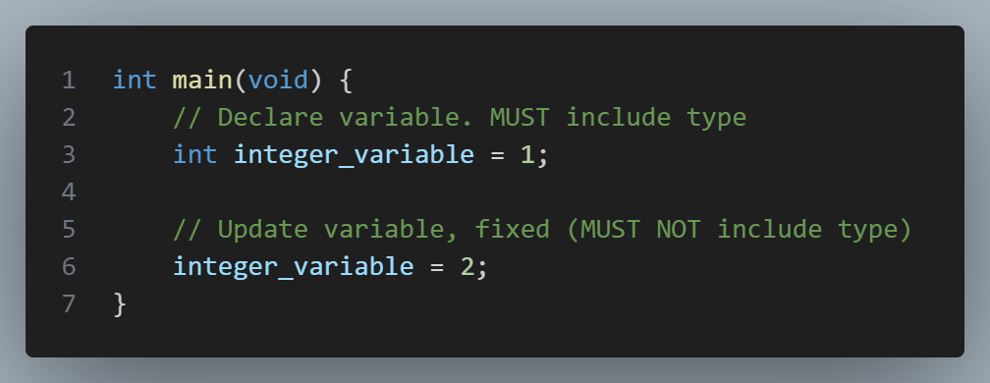
Updating a variable
C syntax

Slide 26
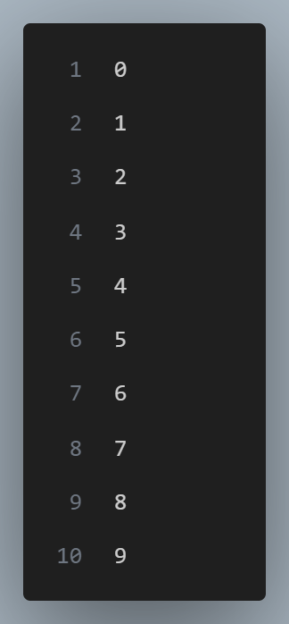
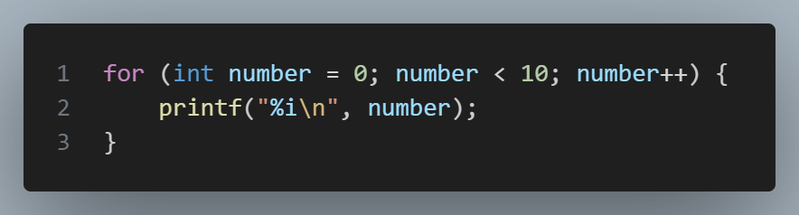
For loop!
C syntax

Slide 27
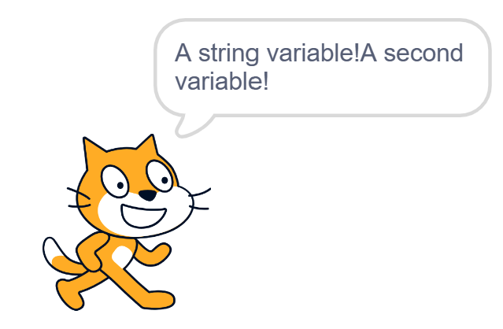
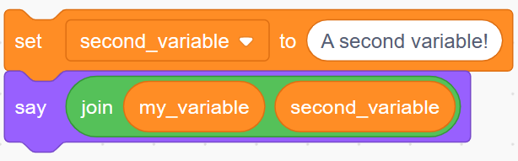
Scratch ‘say’, C printf
Scratch → C

Slide 28
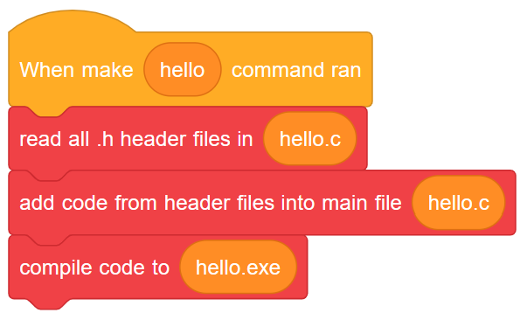
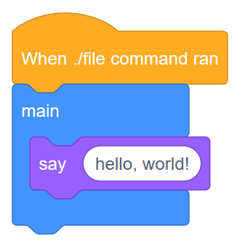
The whole process, in Scratch terms

Slide 29
Whitespace
C syntax

Slide 30
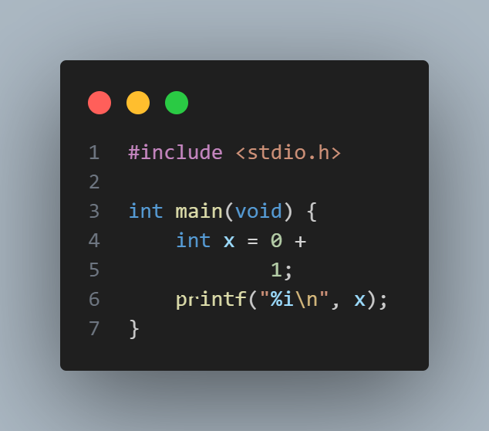
Valid C? (1)
Write your answer here. Is this valid C code? Why or why not? If not, explain how to fix it. What do you think it does?

Slide 31
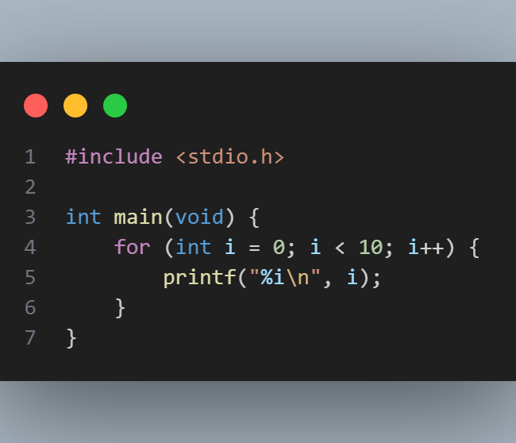
Valid C? (2)
Write your answer here. Is this valid C code? Why or why not? If not, explain how to fix it. What do you think it does?

Slide 32
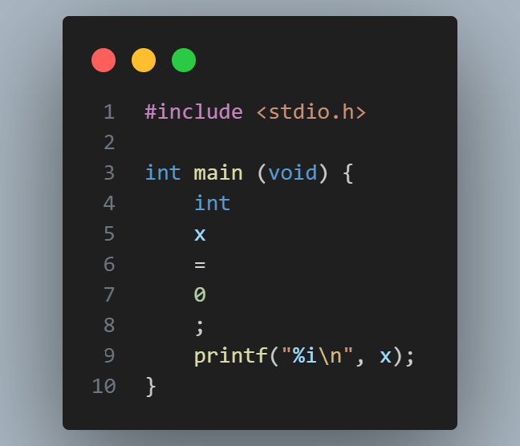
Valid C? (3)
Write your answer here. Is this valid C code? Why or why not? If not, explain how to fix it. What do you think it does?

Slide 33
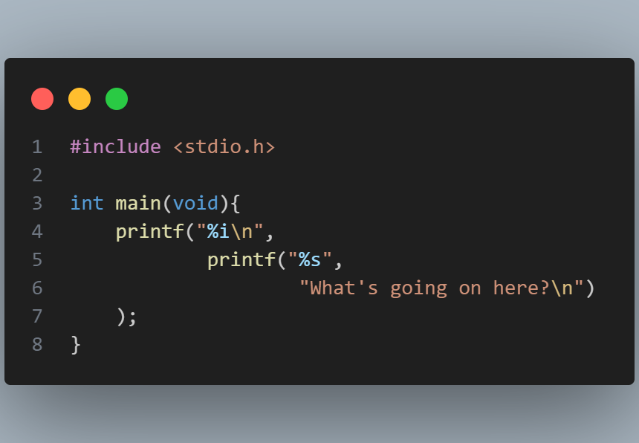
Valid C? (4)
Write your answer here. Is this valid C code? Why or why not? If not, explain how to fix it. If it is valid, what do you think it does?

Slide 34
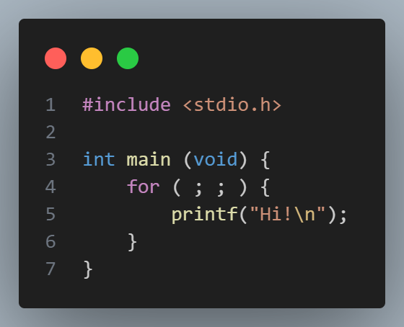
test
Valid C? (5)
Write your answer here. Is this valid C code? Why or why not? If not, explain how to fix it. If it is valid, what do you think it does?

Slide 35
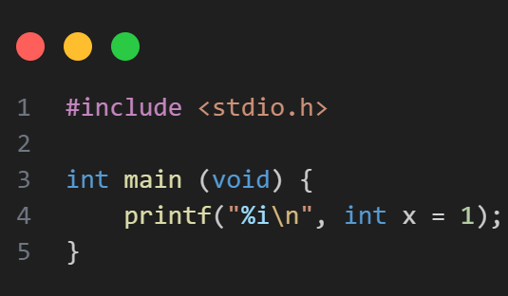
test
Valid C? (6)
Write your answer here. Is this valid C code? Why or why not? If not, explain how to fix it. If it is valid, what do you think it does?

Slide 36
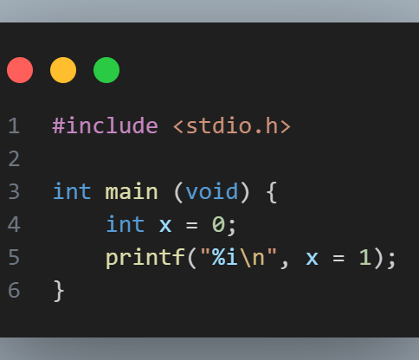
test
Valid C? (7)
Write your answer here. Is this valid C code? Why or why not? If not, explain how to fix it. If it is valid, what do you think it does?

